Slide 1
Sequential model

Slide 2
Attention in seq2seq

Slide 3
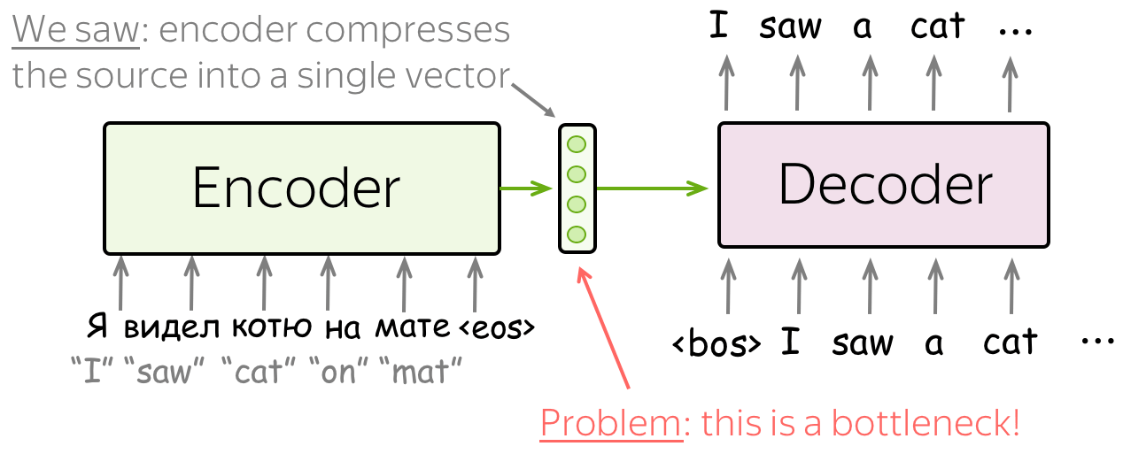
Problem with seq2seq
Notes:
https://jalammar.github.io/visualizing-neural-machine-translation-mechanics-of-seq2seq-models-with-attention/
https://towardsdatascience.com/classic-seq2seq-model-vs-seq2seq-model-with-attention-31527c77b28a
https://towardsdatascience.com/day-1-2-attention-seq2seq-models-65df3f49e263#:~:text=6%20min%20read-,Sequence%2Dto%2Dsequence%20(abrv.,in%20production%20in%20late%202016.d
https://lena-voita.github.io/nlp_course/seq2seq_and_attention.html

Slide 4
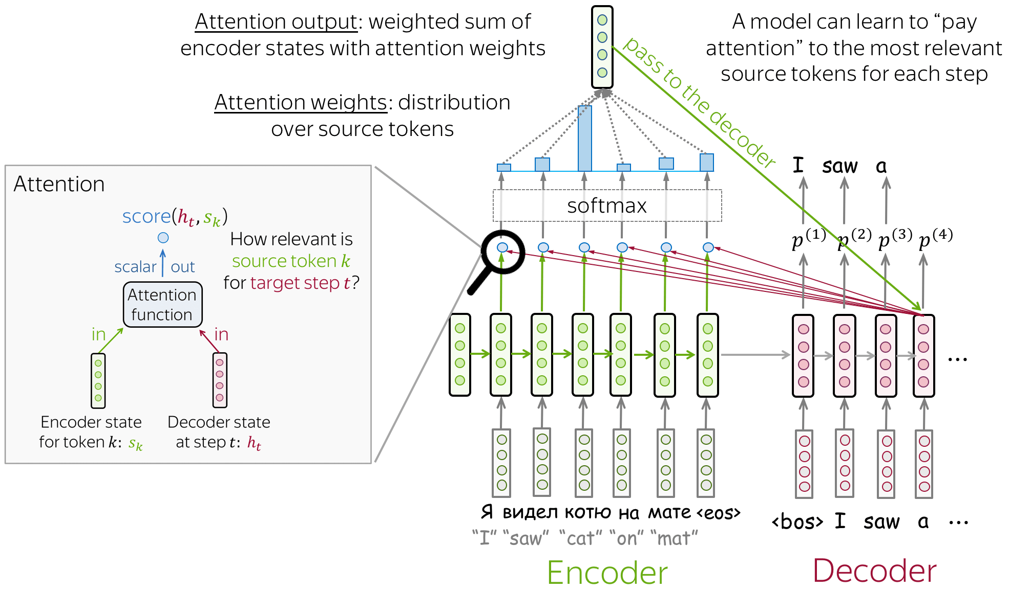
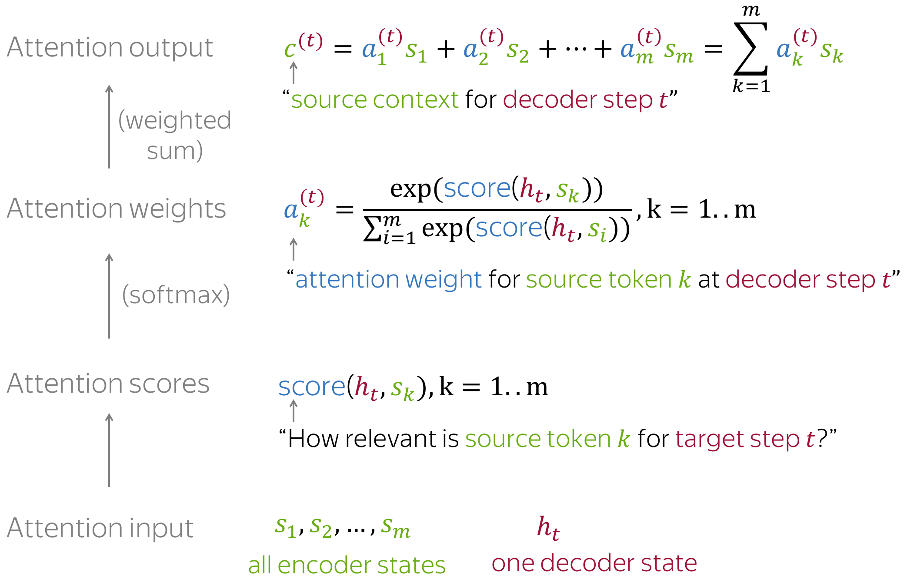
Attention

Slide 5
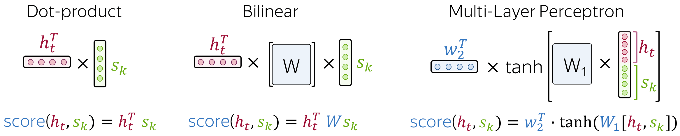
Attention score

Slide 6
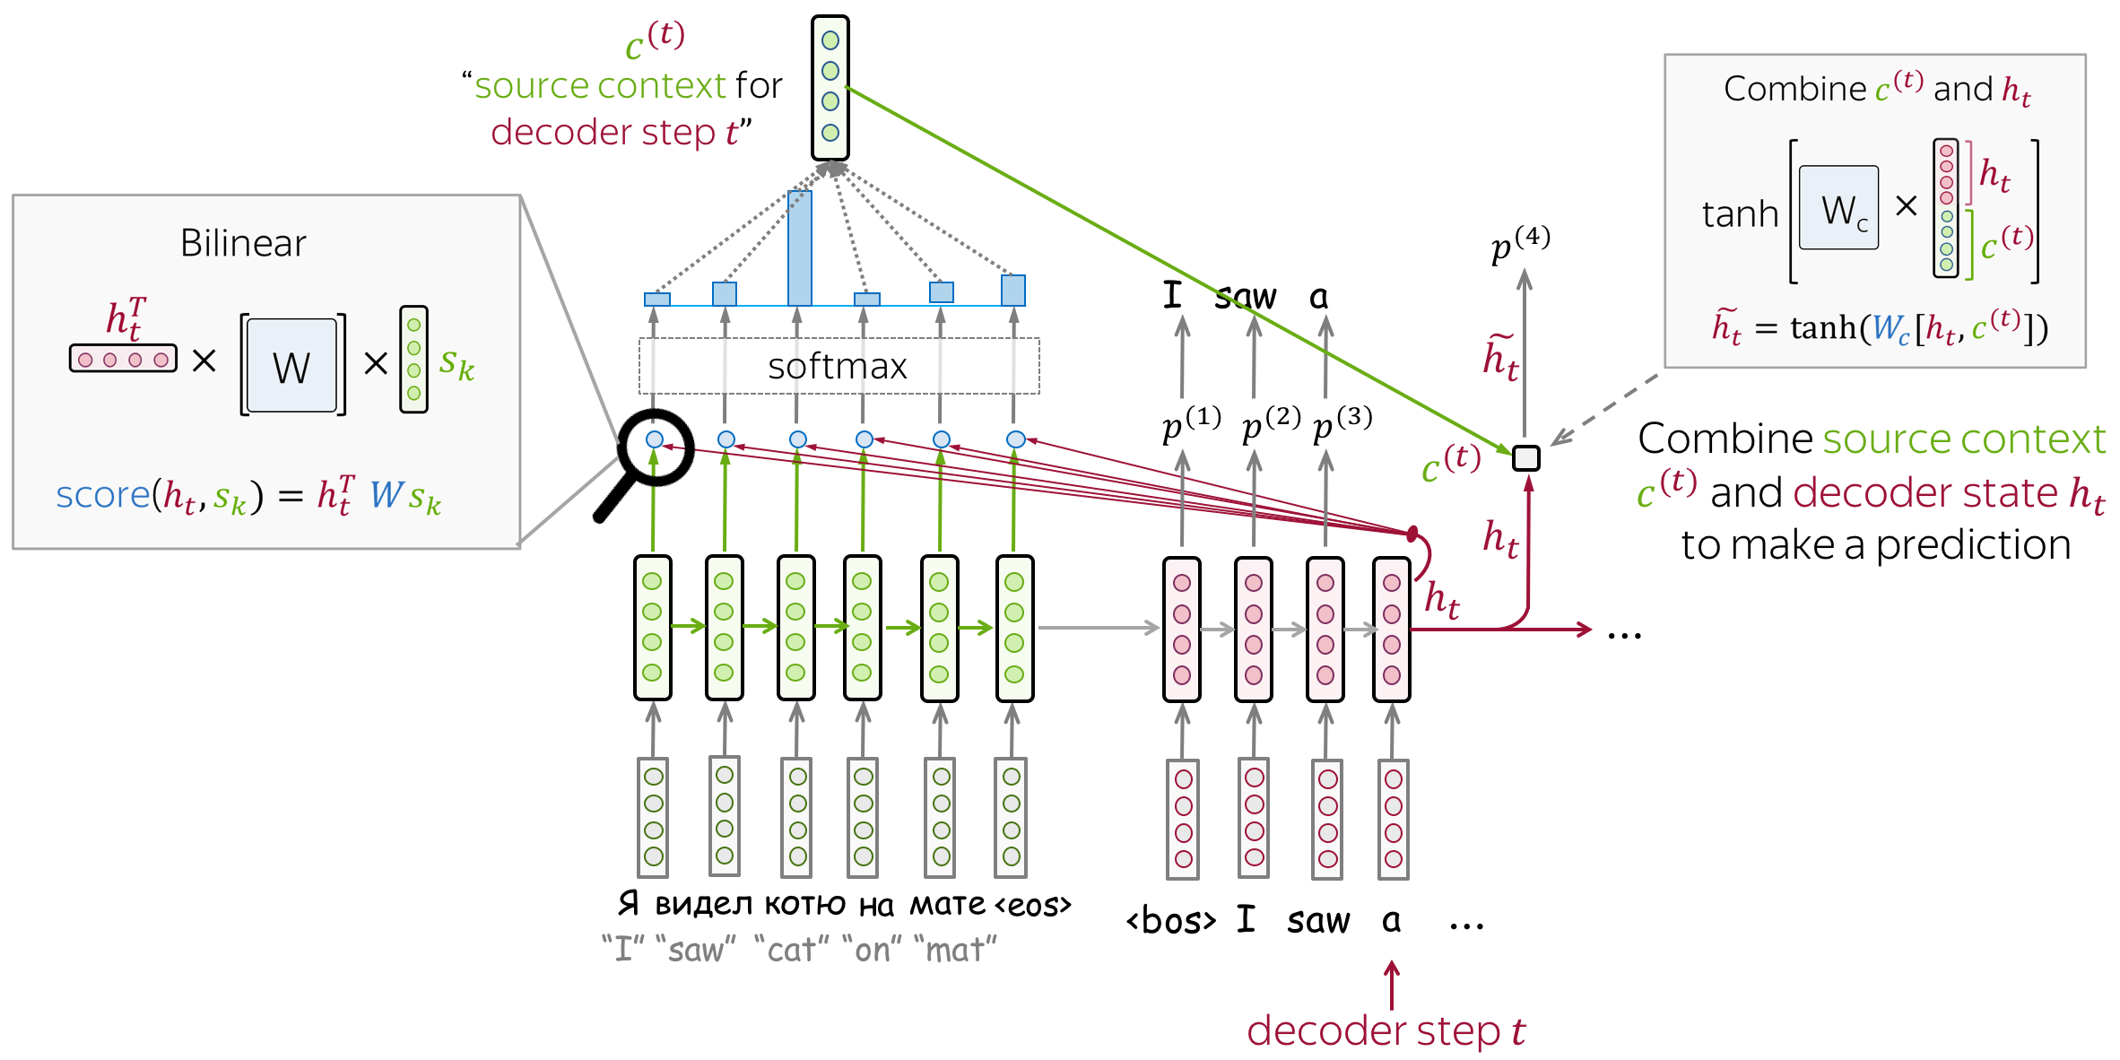
Luong model
encoder: unirectional (simple)
attention score: bilinear function
attention applied: between decoder RNN state t and prediction for this step Attention is used after RNN decoder step t before making a prediction. State ht used to compute attention and its output c(t). Then ht is combined with c(t) to get an updated representation h~t, which is used to get a prediction.

Slide 7
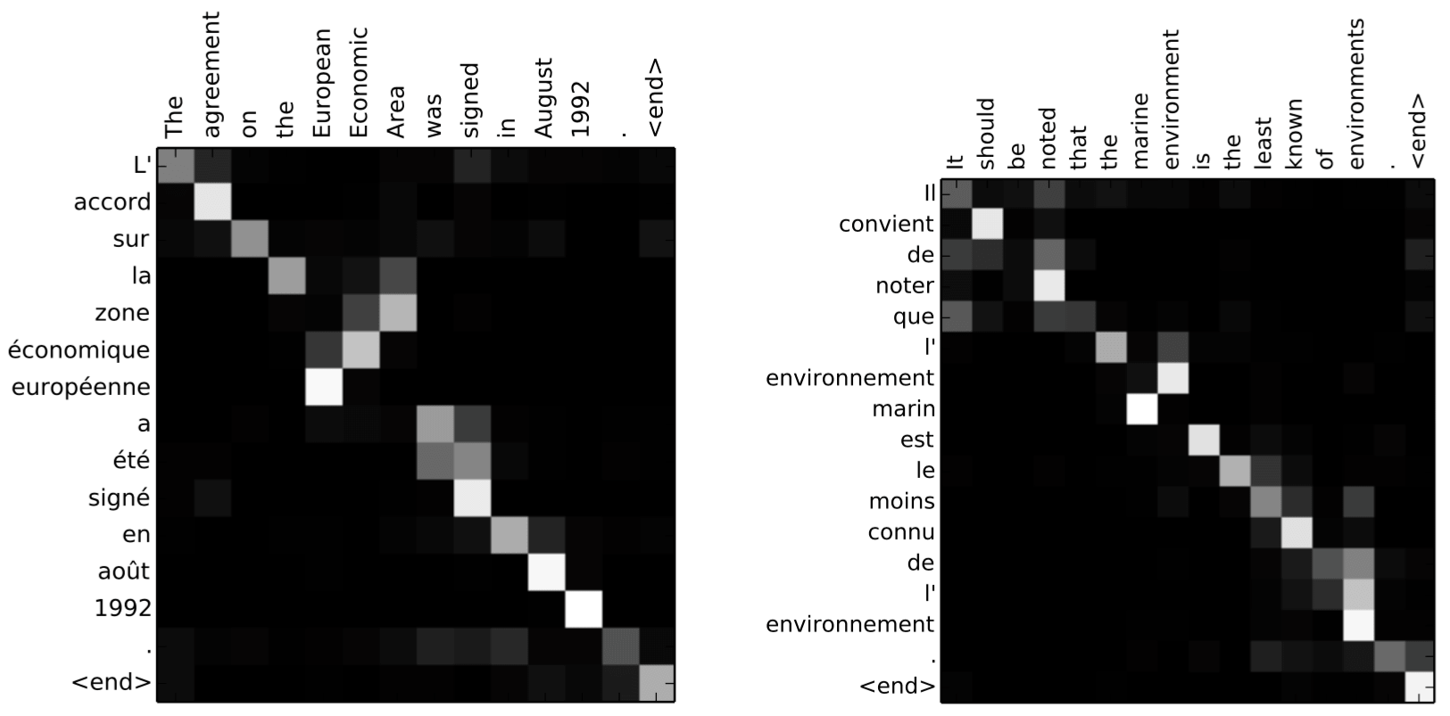
Attention weights

Slide 8
Optimization

Slide 9
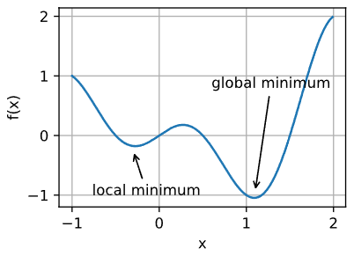
Local minima

Slide 10
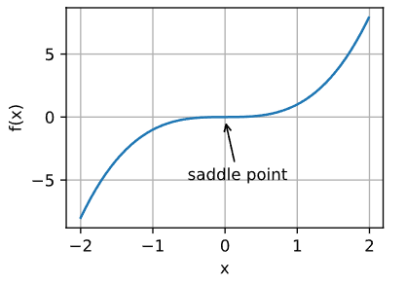
Saddle point

Slide 11
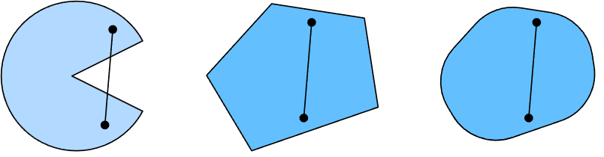
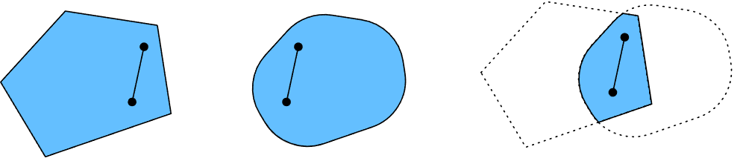
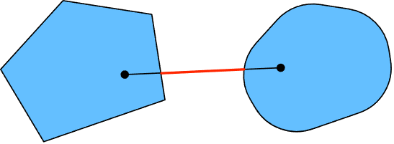
Convexity
Notes:
https://d2l.ai/chapter_optimization/convexity.html

Slide 12
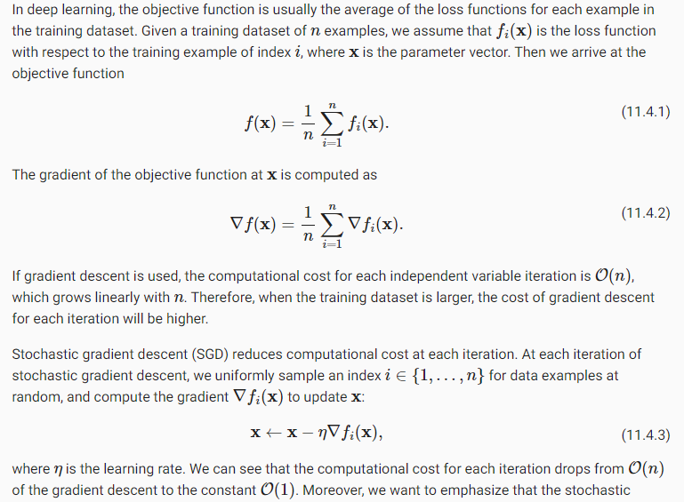
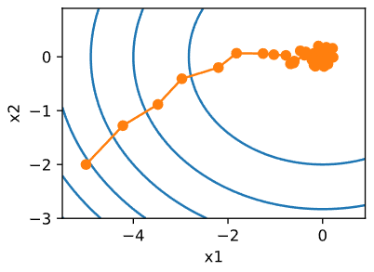
Stochastic Gradient Descent

Slide 13
Minibatch SGD

Slide 14
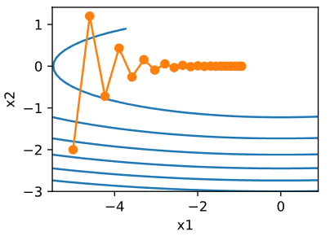

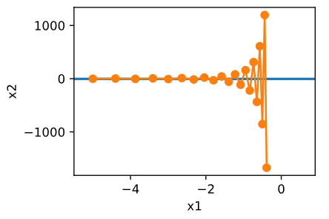
Momentum
Notes:
https://d2l.ai/chapter_optimization/momentum.html

Slide 15
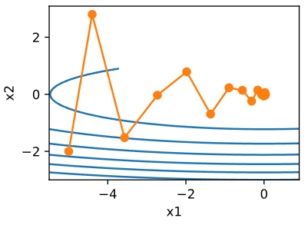

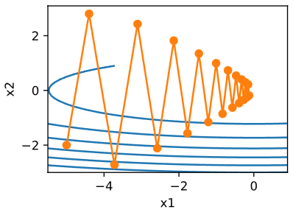
Momentum

Slide 16
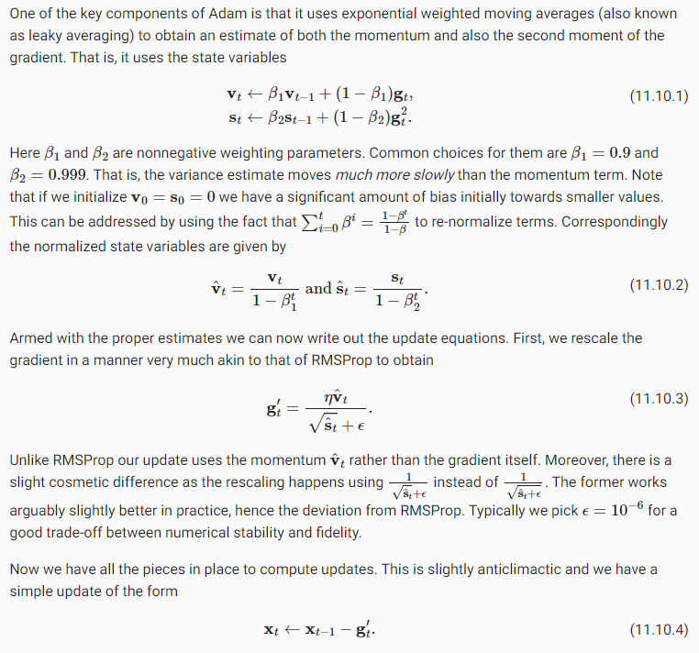
Adam

Slide 17

Learning rate scheduler
Change lr using number of iteration
(code)

Slide 18
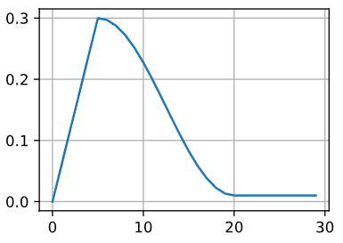
Warmup
use a warmup period during which the learning rate increases to its initial maximum and to cool down the rate until the end of the optimization process

Slide 19
Summary
Decreasing the learning rate during training can lead to improved accuracy and (most perplexingly) reduced overfitting of the model.
A piecewise decrease of the learning rate whenever progress has plateaued is effective in practice. Essentially this ensures that we converge efficiently to a suitable solution and only then reduce the inherent variance of the parameters by reducing the learning rate.
A warmup period before optimization can prevent divergence.
Optimization serves multiple purposes in deep learning. Besides minimizing the training objective, different choices of optimization algorithms and learning rate scheduling can lead to rather different amounts of generalization and overfitting on the test set (for the same amount of training error).

Slide 20
Practice
Seq2seq with attention
Bai tap giua ki

